Slide 1
EASYWORK
Class Diagram and Entity-Relation Diagram
Software Project Management Tool
A2 - Group 3 Presented By:
1705047
1705050

Slide 2
Sequences
Login/Register
Project Planning
Task Creation and Assigning
Risk Assessment
Project Scheduling
Cost Estimation and Resource allocation
Developer Interface
Communication
Project Control Management
Quality Assurance

Slide 3
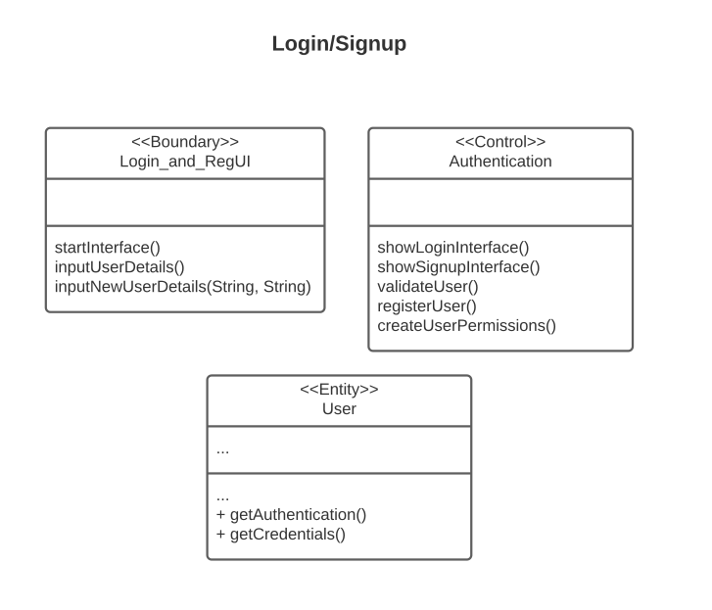
Login/Register

Slide 4
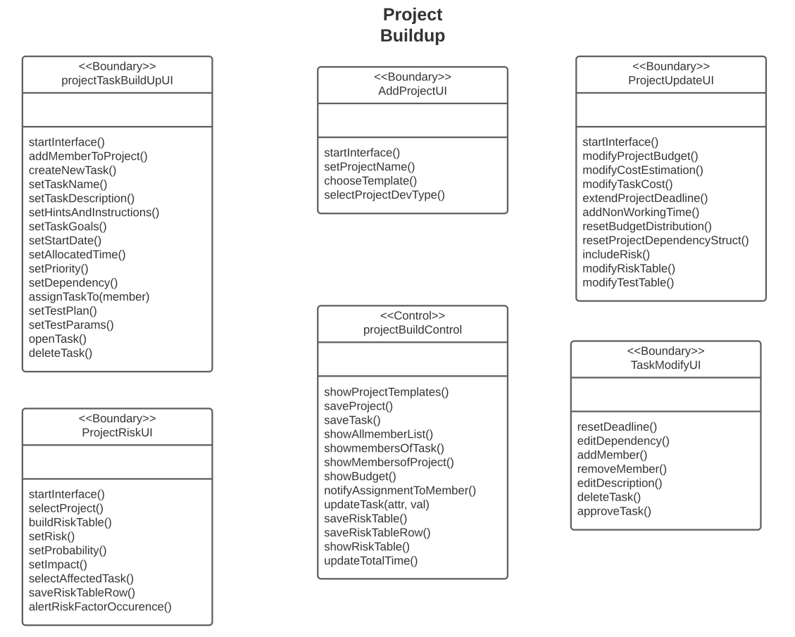
Project Buildup and Task Assignment

Slide 5
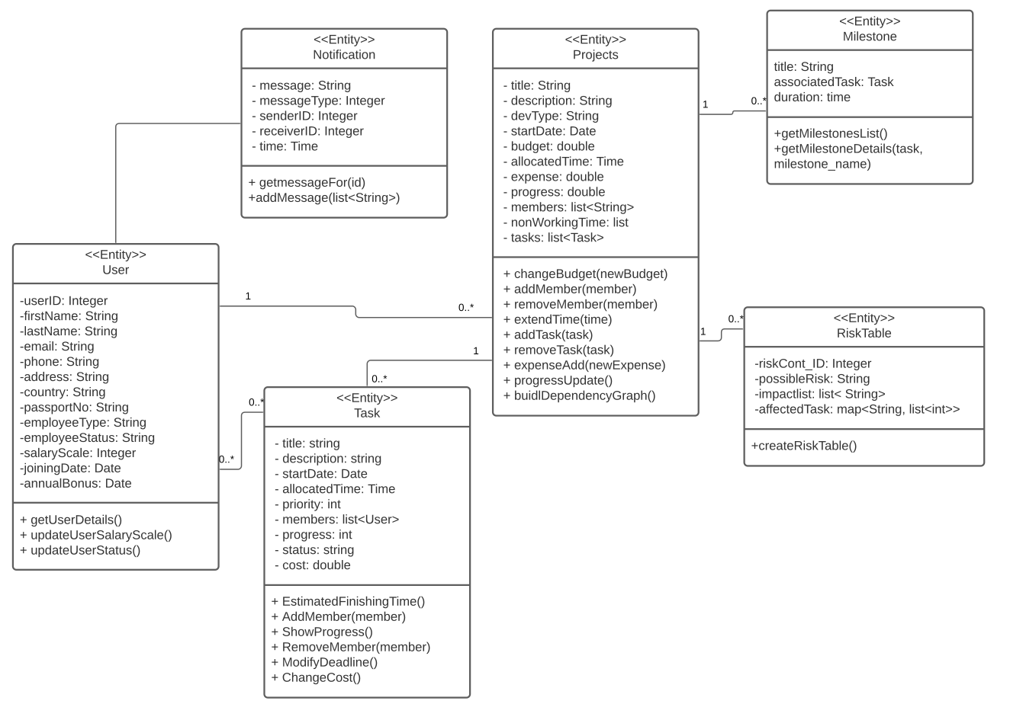
Project BuildUp Entity Class

Slide 6
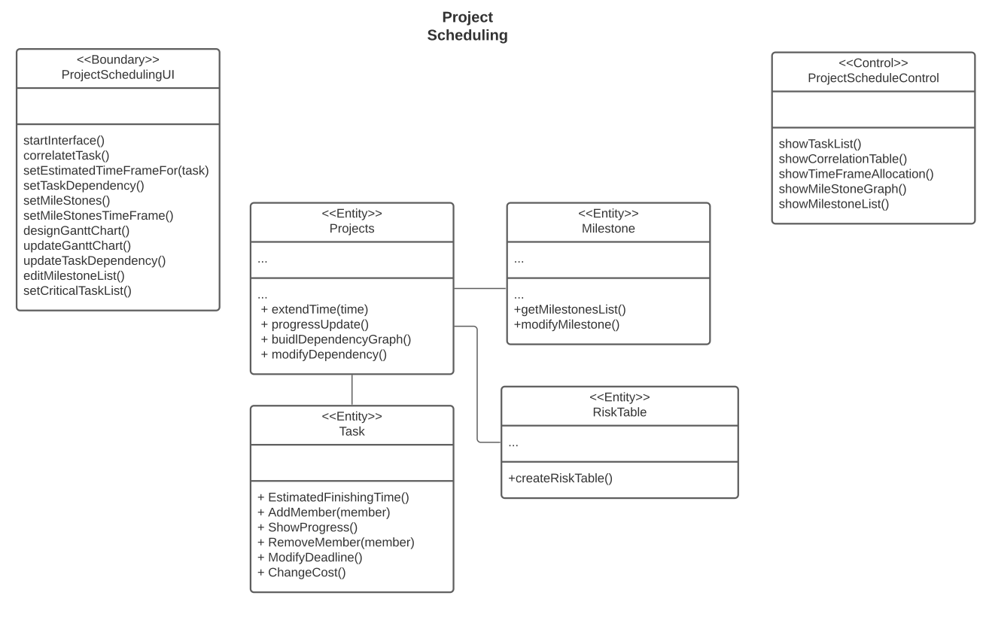
Project Schedu-ling

Slide 7
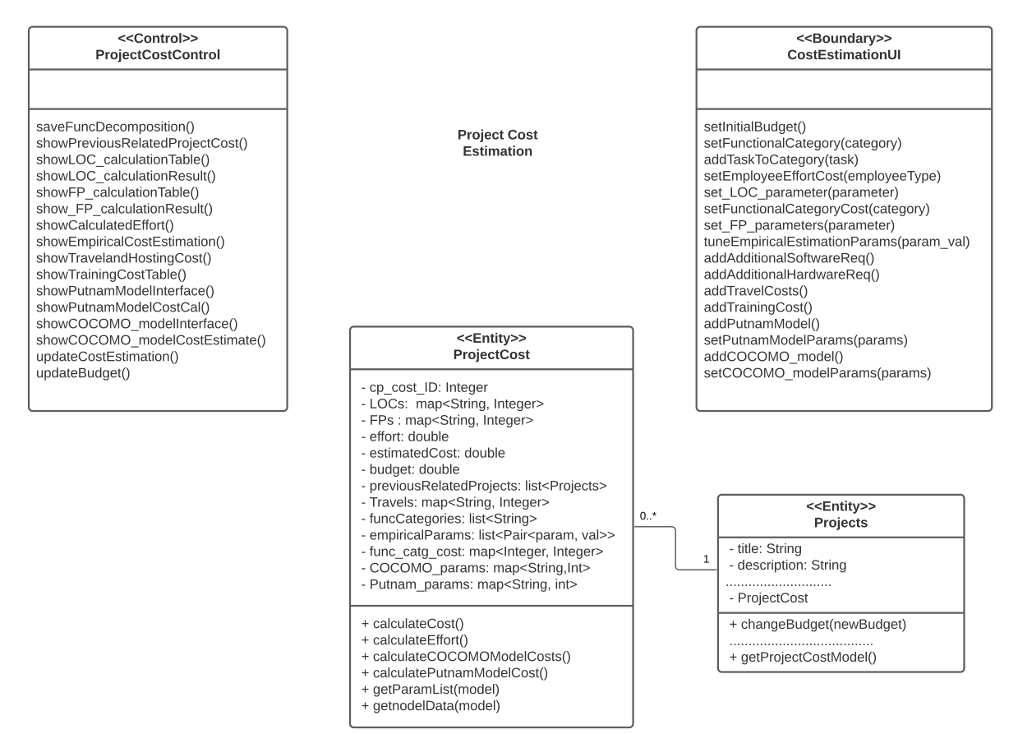
Project Cost Estimation

Slide 8
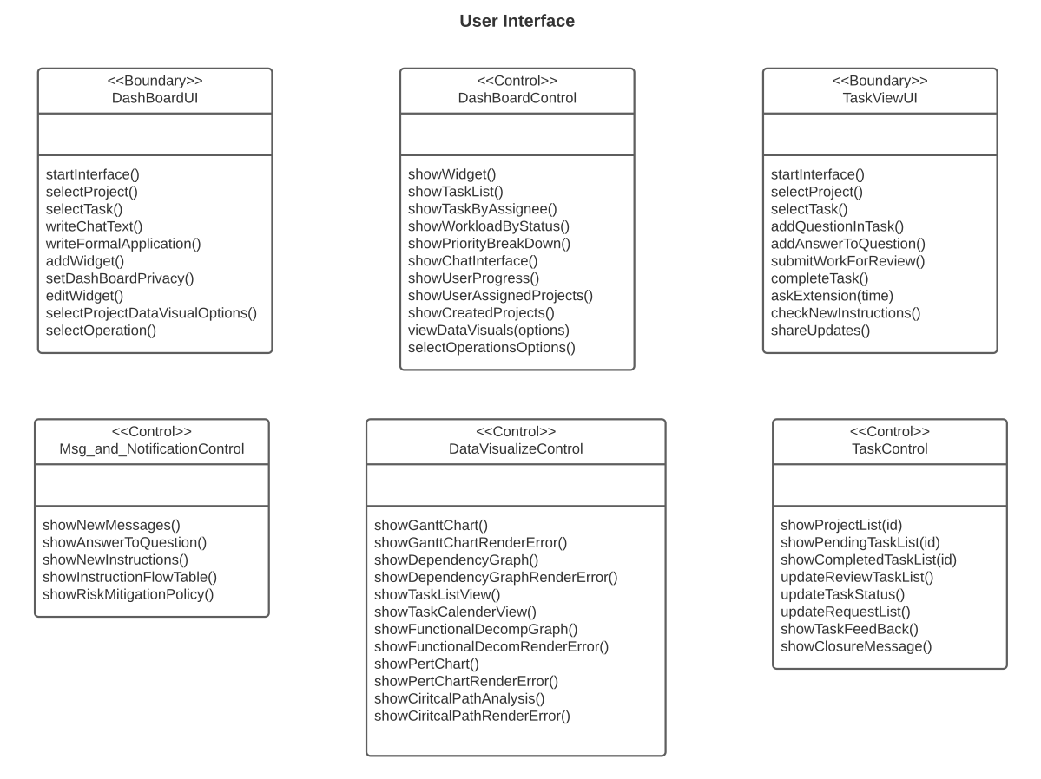
User Interface

Slide 9
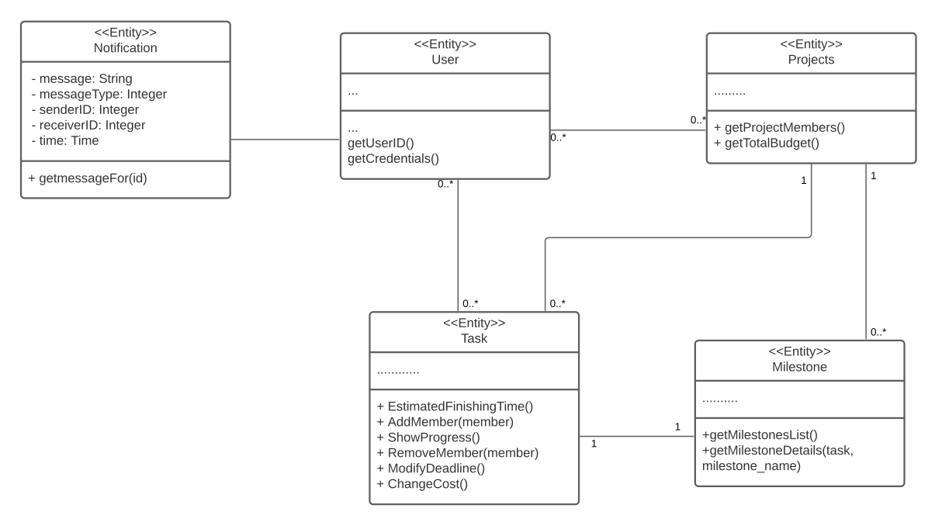
User Interface

Slide 10
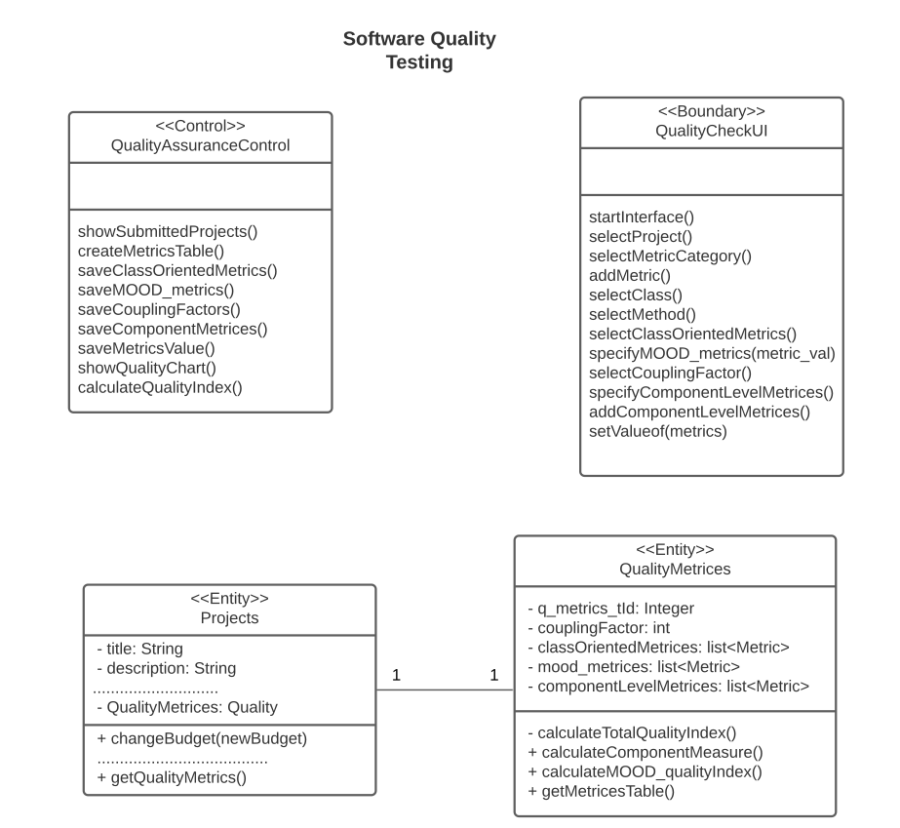
Quality Testing Interface

